Slide 1

Welcome
EIC EDGE – Week 1 Software Development Methodology
Notes:
Mandatory
ACTION: Adjust title to fit your course.

Slide 2


Hello
About me...
25+ years in the indusry
20+ years in teaching
Certified Cloud architect
Passionate about learning
Also, passionate about Reese’s Cups!
Allen Sanders
with DevelopIntelligence, a Pluralsight Company.
Notes:
Mandatory
ACTION: Adjust objectives to fit your course.
Script: I am [insert name] with DevelopIntelligence. We’re the training partner for [insert client name]. [Provide brief info on your background.]
Wing it!!! Keep it short!!! (Under 2 minutes; less than 1 is even better). Your goal is to establish rapport. You’re just trying to connect with the students. For example...
Here’s a little about my background in case you want this for reference later. Fun fact: [insert a piece of trivia about your personal life…”When I’m not teaching or coding, I am a skydiver”…whatever cool hobby you are engaged in]
Avoid putting your resume here. Say only a sentence or two about your professional credentials and invite them to ask questions about your background or experiences at any point during the training.

Slide 3
Prerequisites
This course assumes you:
Have some education and experience in Computer Science and software development
Have completed basic onboarding

Slide 4
Why study these subjects?
Quality software engineering is built upon a solid software development methodology
Knowing how iterative software development works helps you confidently contribute from your role
Understanding Agile principles helps you work more effectively in teams
Understanding DevOps (and DevSecOps) orients you to Capital Group’s tech culture and enables secure continuous improvement
Being familiar with JIRA and how it’s used helps you create, track and contribute to technology workflows
Knowing how to use GitHub positions you for divide-and-conquer on project completion

Slide 5








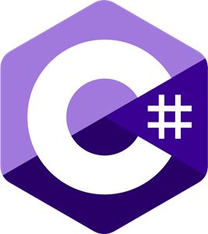















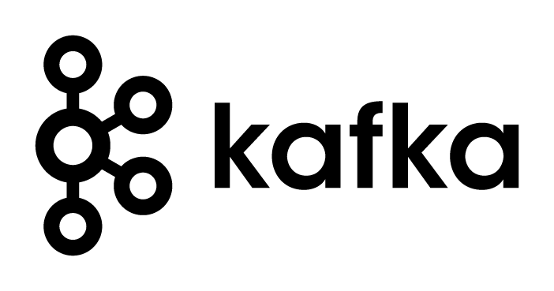








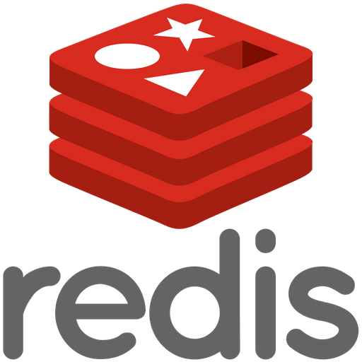




We teach over 400 technology topics
Notes:
Mandatory
Script: DevelopIntelligence teaches a lot of different tech. If there’s a technology you want to learn and you don’t see it in your company’s learning catalog, let your manager know. We’d be glad to help.”

Slide 6



You experience our impact on a daily basis!
Notes:
Mandatory
Script: In your everyday life, you come across tech many times a day. When you shop online. When you pay for your morning coffee. When you watch a movie or travel. We train software developers and IT professionals who work on many of the products and services you use daily.
In fact, when you talk on the phone, watch a movie, connect with friends on social media, drive a car, fly on a plane, shop online, and order a latte with your mobile app, you are experiencing the impact of our solutions.

Slide 7
My pledge to you
I will...
Make this interactive
Ask you questions
Ensure everyone can speak
Use an on-screen timer
Notes:
Mandatory
Script: This is my pledge to you. I’d like to talk in particular about the third bullet. Sometimes in a class, an enthusiastic participant will want to speak out in every discussion, answer every question and so forth. I want to make sure all of you have the opportunity to be heard. So, if I haven’t heard from you in awhile, I may call on you or check in via chat, because I want to make sure everyone gets their questions answered. Also, I want to demonstrate the timer and confirm that everyone can see it. EggTimer is a good timer - https://e.ggtimer.com/

Slide 8
Objectives
At the end of this course you will be able to:
Describe key aspects of iterative software development and understand your role in the process
Participate in Agile work efforts in a confident and meaningful way
Understand and help to improve the DevSecOps culture at Capital Group
Work within JIRA to manage work and break down complex tasks
Use GitHub to effectually manage and contribute on important source code assets
Notes:
Mandatory
ACTION: Adjust objectives to fit your course.
Use measurable objectives that start with action verbs such as: describe, define, identify, assess, demonstrate, use, utilize. https://elearningindustry.com/writing-learning-objectives-for-elearning-what-elearning-professionals-should-know

Slide 9
Agenda
Day One
Software development methodologies and iterative software development
Software Development Lifecycle (SDLC)
Day Two
The Agile Manifesto and best practices in Agile/Scrum
Working with JIRA
Notes:
Day 1 - Software Development Methodologies + SDLC (don't use Scrum Master, use Scrum Lead)
Scrum
Ceremony (sprint planning, backlog grooming, retros, demos)
Pointing (Fib or similar for relative sizing)
Real life examples to include to make less theoretical
Day 2 - Agile Manifesto + Best Practices, Working with Jira
Focus more on best practices & why behind it
Iterative approach to software development
Incremental improvement
Working with Product Owners/Product Managers

Slide 10
Agenda
Day Three
Introduction to DevSecOps
Introduction to Test-Driven Development (TDD)
Day Four
GitHub Part 1
Day Five
GitHub Part 2
Notes:
Day 3 - Intro to DevSecOps, Introduction to TDD (Automated Testing Concepts, Tools, and FWs)
Shifting left
Static + Dynamic scans
Container scans?
Code quality - code coverage, cyclomatic complexity, unit tests passing, etc.
The 3 Laws
Code coverage
Technical debt
Motivation for automated testing
Days 4,5 - GitHub (Version Control, Branching, Tagging)
Version control
Branching
Tagging
Pull requests

Slide 11
How we’re going to work together
Lab work will take place in individual workspaces – isolated, browser-based virtual machines
Classroom labs may include individual work as well as group discussion and work
I welcome being interrupted – if you need more info, or clarification, or anything else, just break in and ask. I am here to help you.
Notes:
Mandatory
ACTION: Adjust bullets as per your course.
In this section, discuss the structure of the course—exercises, labs, etc.
Also, discuss any resources students will be using.

Slide 12
Software Development Methodologies and Iterative Software Development

Slide 13
Common Approaches to Software Development
Waterfall
Iterative

Slide 14
Waterfall Software Development
A sequential development process that flows like a waterfall through all phases of a project (requirements, design, implementation, testing, and deployment for example), with each phase completely wrapping up before the next phase begins.
Key aspects:
Majority of research done up front
More accurate time estimates
More predictable release date
Cons:
Process is brittle – can’t pivot easily in terms of changing requirements
Long lead times – difficult to respond to rapid business evolution
Tools:
Commonly use Gantt charts to track projects, subtasks and dependencies

Slide 15
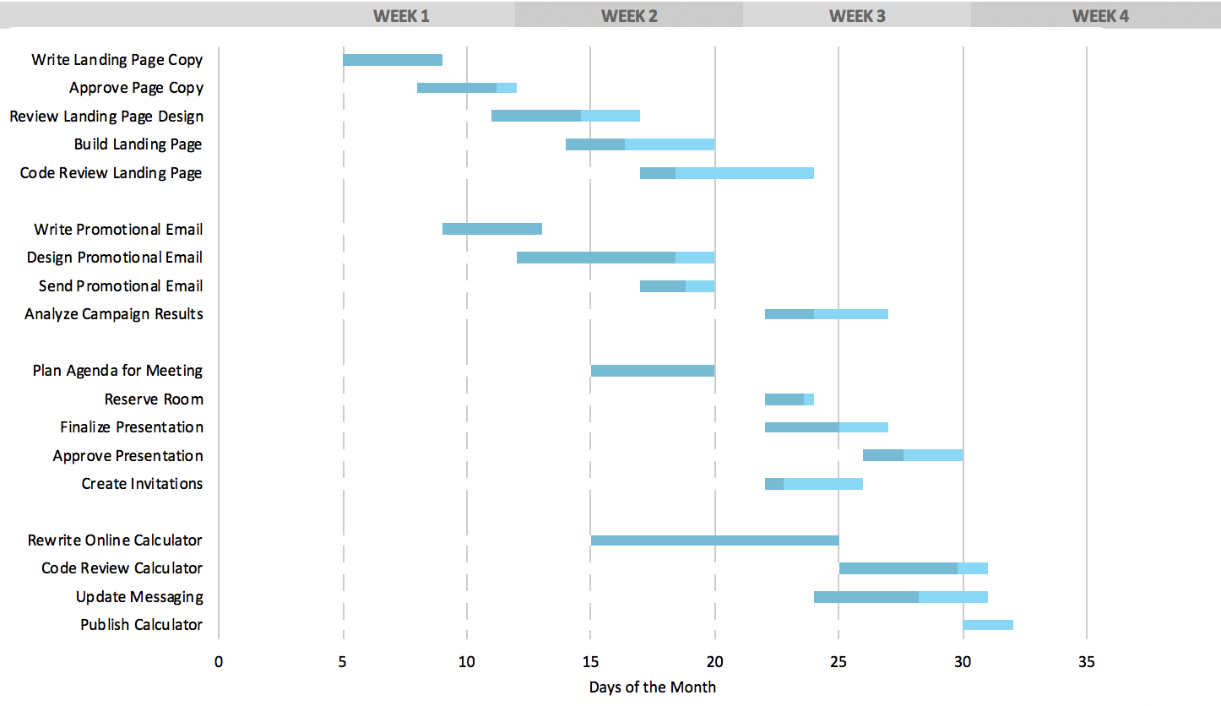
Typical Gantt Chart

Slide 16
Agile Software Development
A group of software development methodologies based on iterative development.
Requirements and solutions evolve through collaboration between self-organizing cross-functional teams.
Key aspects:
Incremental delivery
Always ready to ship
Continuous inspection of work product and process provides feedback for continuous improvement
We will explore Agile in more detail later in this class

Slide 17
ESSAY:
Describe the software development or project management approaches you have worked with, and your opinions on the pros and cons of each
Notes:
This shouldn’t be a long essay, and doesn’t need to conform to university standards ☺
It’s more important that you communicate how the systems worked, in plain language – and what it was like to work in those systems. Talk about WHY you think something worked well, or didn’t
Please write your essay in a .txt file and send it to the instructor
Your experience with various software development systems (3-5 sentences)

Slide 18
Iterative Software Development
Key elements:
Incremental improvement to code and process
Always ready to ship
Iterative feature development
Working with the Product Owner
Pivoting mid-development

Slide 19
Incremental improvement to code and process
Principle: Using feedback obtained from regular examination of product and process lets you incrementally improve both
Key aspects:
Work in short cycles (1-6 weeks) composed of overlapping phases: requirements, design, programming, testing.
Build on what was built before and produce a working product at each stage. Gather customer feedback at the end of each iteration.
Each iteration, evaluate the team’s performance. Change internal process as needed to improve quality of estimation and delivery.

Slide 20
Always ready to ship
Principle: after the first iteration, the product is always "ready to ship". That is, the product does something useful and is in a releasable state.
Key aspects:
This is a risk mitigator – if the project is cancelled or greatly reduces in scope, there is still something of value to show for the work efforts
Projects are less likely to be cancelled, as there is always a working product that shows the project’s value and the team’s competence
Key practices that support this principle:
Do daily software builds
Fix bugs right away
Relentlessly use automated testing to mitigate regression

Slide 21
Iterative Feature Development
Principle: Instead of building all features and then releasing (waterfall), instead develop one feature, then the next, always keeping the application in a shippable state. Continually re-assess priority of feature development, including refinement of existing features, based on feedback
Key aspects:
Work closely with all concerned parties
All involved need to understand and appreciate that development on project will be iterative
Application reviewed at demo is still “work in progress”
Focus is on gathering “real-time” feedback so course corrections can be made if required
Key practices that support this principle:
Set expectations for all stakeholders
Educate stakeholders on iterative development so they are effective contributors
Be willing to change

Slide 22
Working with the Product Owner
Principle: working closely with the Product Owner enables the incremental production of shippable features that are valuable to the end user
Key aspects:
Consult with the product owner before each iteration, agreeing on the scope and details of work for that iteration.
During the iteration, the external customer or project manager cannot change the scope for that iteration, but the development team may change the scope by dropping features if the end date will not be met.

Slide 23
Pivoting mid-development
Principle: An agile, iterative process can allow a project to pivot in small or large degree, mid-process, without excessive cost of time or resources
Key aspects:
Manage to meet business goals, due dates and budgets. Be willing to change requirements to fit these, not the other way around.
Learn as you go; be adaptable to new or changing business needs that become clear only after development begins.
Analyze existing implementations frequently to determine that they are meeting business goals.

Slide 24
Software Development Lifecyle (SDLC)

Slide 25
Software Development Lifecycle (SDLC)
Release
Plan
Operate
Test
Develop
Feedback

Slide 26
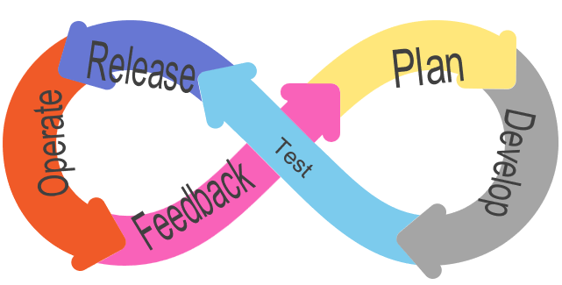
Plan Phase
Focus:
Deciding on the set of user stories for team focus over the upcoming iteration
Refining those stories to ensure all required detail to complete is in place
Identifying key requirements (both functional and Quality of Service) that need to be met
Notes:
Requirements definition at this stage should include things like security requirements (threat modeling, test needed to shift security left)

Slide 27
Develop Phase
Focus:
Executing coding tasks that will complete the set of user stories in scope for the iteration
Implementing automated unit tests that can continue to confirm requirements met
Addressing any potential security vulnerabilities in the code being built
Ensuring the full body of source code created to date (including new code) remains “clean”
Ensuring new code gets correctly merged with existing code and code added by other members of team
Notes:
Clean code – means code that is easier to read, easier to test, easier to maintain long-term; can include refactoring (seeking to improve internal structure of code without impacting external operation). Extracting methods, renaming, reuse, etc.

Slide 28
Test Phase
Focus:
Code updates from all team members built as a single, comprehensive unit
Seeks to validate that all the code operates correctly together
Through automated integration tests, verifies requirements successfully satisfied
Likely includes deployment to pre-production environments for testing
Can include automated security scans as well to help find security vulnerabilities early

Slide 29
Release Phase
Focus:
Installing required runtime, compiled binaries, and configuration to the production environment
May include small set of “smoke tests” (test transactions that can be run through the system to validate at a macro level)
Verification that all infrastructure and configuration is in place for user access
Ensuring that required documentation is up-to-date for production support

Slide 30
Operate Phase
Focus:
Ensuring that the application remains healthy in production
Addressing any production incidents encountered during application operation
Identifying and tracking any issues/bugs that need to be elevated from “incident” to “problem” status
Notes:
Incident – single (or discrete number of occurrences); may be able to execute a workaround for immediate relief
Problem – something more endemic that will likely require a code fix
Incident status is first sign of issues and can elevate to problem

Slide 31
Feedback Phase
Focus:
Gathering business stakeholder, technology stakeholder, and user feedback on how application is operating post deployment of most recent iteration (and overall)
Can include explicit demo to project team as part of closing out current sprint
Goal is uncovering opportunities to continuously improve the product and getting those opportunities documented for inclusion in future sprints

Slide 32
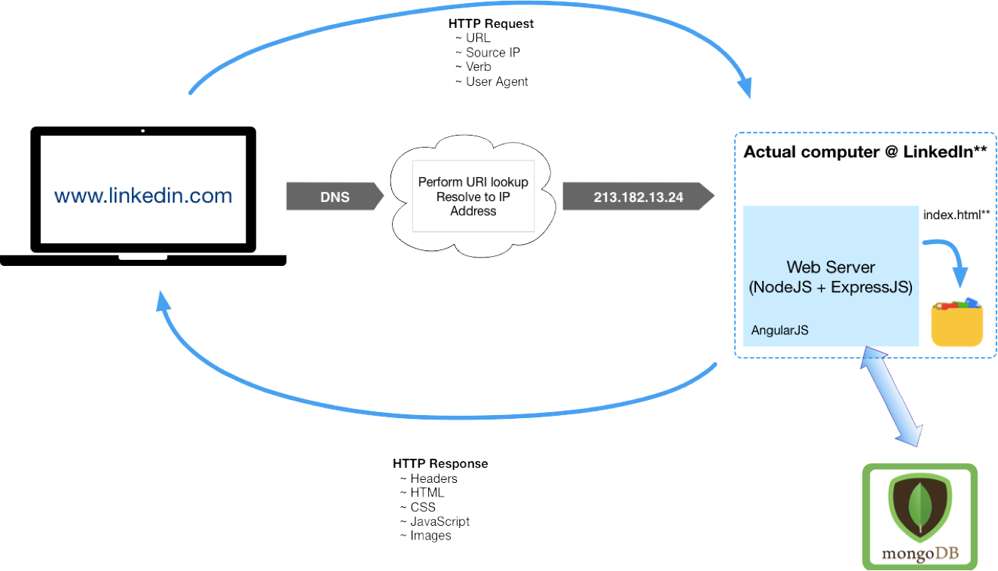
Elements of a Full-Stack App and HTTP Request/Response Cycle
Actual computer running app
www.theapp.com
Front-end framework

Slide 33
WORKSHOP:
Group discussion considering the Reference Implementation from the following points of view:
Itemize the set of high-level features that will be needed to implement this application?
Which features should be implemented first? Which features should ship first?
How might your approach need to pivot, based on market or other factors?
Looking at the “Reference Implementation” from an iterative approach

Slide 34
WORKSHOP:
Group discussion considering the Reference Implementation from the following points of view:
Based on your prioritization of the features that should be implemented/shipped first (from the previous discussion), what should your first two iterations look like?
Include tasks for each phase (Plan, Develop, Test, Release, Operate)
What are some practical ways to gather feedback on the features deployed as part of the first two iterations?
Looking at the “Reference Implementation” from an iterative approach

Slide 35
The Agile Manifesto and Best Practices

Slide 36
The Agile Manifesto and its Origins
What is it? A statement of values regarding approaches to how teams create and ship software
When was it made? 2001, by 17 top software developers and consultants
Key aspects:
12 values were agreed upon
These values are NOT a process, implementation or standard; they are opinions
Many popular project management methodologies have arisen that are based on these values
Many Agile implementations are poorly executed; it takes great cooperation between business leadership and a competent, self-guided dev team to make it work

Slide 37

Agile Values
Individuals & Interactions
Processes & Tools
Working Software
Comprehensive Documentation
Customer Collaboration
Contract Negotiation
Responding to Change
Following a Plan

Slide 38
Key Elements of the Agile Approach
The Agile method is an iterative and incremental tactic to software design that utilizes constant planning, understanding, upgrading, team partnership, development, and delivery.
It is driven by the principles of providing value and collaborating with stakeholders.
It starts with customers defining the end uses of the final product and the kind of problems the final product attempts to address.
Designated teams start to plan and work on a complete process through planning, implementing, and appraising.
Since the development process is iterative, errors are resolved in the intermediate stage of the project.

Slide 39
Modern Approaches to Agile Software Development
Several project management approaches implement Agile values in some way. Often, they bring in elements of other approaches.
Popular methodologies:
All three of these approaches are in use in some fashion at Capital Group.
Kanban
Uses visual boards to view & organize tasks
Uses elements of “just in time” lean manufacturing strategies
Scrum
Aligns closely with Agile values
Breaks down product development into iterative sprints
Scaled Agile Framework (SAFe)
Workflow and organizational patterns to help deploy Agile at scale
Can support large organizations
Emphasizes throughput
Makes use of exclusive roles (“Scrum Lead”, “Product Owner”)
Emphasizes constant communication

Slide 40
Common Agile Practices at Capital Group
Common practices are:
Close collaboration between an engaged and knowledgeable Product Owner and a self-organizing dev team with strong ownership for code and team quality
Relentlessly working to break complex tasks down into smaller, more discrete and defined elements
Making use of Scrum boards to track and prioritize work
Sprints run using Scrum principles and practices
Continuously evaluate and improve how we choose scope of work for each iteration

Slide 41
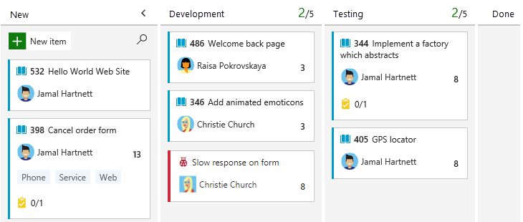
Typical Kanban Board

Slide 42
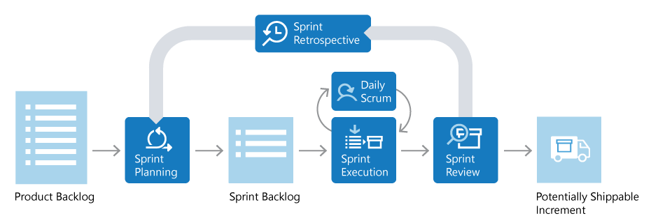
Diagram of Typical Scrum Sprint
Source: https://docs.microsoft.com/en-us/devops/plan/what-is-scrum

Slide 43
Scrum Roles
Product Owner
Scrum Lead
Scrum Team

Slide 44
Scrum Roles
Product Owner
Responsible for what team builds and why
Keeps backlog up to date and in correct priority order
Scrum Lead
Scrum Team

Slide 45
Scrum Roles
Product Owner
Ensures that Scrum process is followed by team
Responsible for the fidelity of the process
Part coach, part team member, part cheerleader
Scrum Lead
Scrum Team

Slide 46
Scrum Roles
Product Owner
Scrum Lead
Scrum Team
People building the product
Responsible for product build (and associated quality)

Slide 47

Product Backlog
Prioritized list of work the team will deliver
Product owner manages – adds, changes, reprioritizes as needed
Items at the “top of the list” get worked first

Slide 48

Backlog Grooming
Regular team activity which allows group to verify that quality of defined sprint items remains high
Team discusses each item and ensures that all required information to successfully complete is in place
For example, has the item been given an adequate description and does the acceptance criteria provide team members with the information needed to assess “done”?
Backlog item is assigned “points” representing relative level of effort to complete
Points are not directly correlated to hours – instead, about amount of effort required for the task in comparison to previous tasks completed or other tasks planned
There will likely be some number of points for items that is considered “too high” to complete as a single item
Provides threshold for determining when to divide a large task into smaller parts
Notes:
Will talk in more depth about characteristics of sprint items/cards in the section on Jira
One common pointing system used is Fibonacci (but not only approach)
Team can also use techniques like “planning poker” (https://www.planningpoker.com/) to help ensure objective pointing (minimize effect points assigned by another team have on your own)

Slide 49

Sprint Planning
Team chooses items from the backlog to target for upcoming sprint (based on prioritization by Product Owner)
Intended to represent amount of work team thinks they can complete within the sprint
Items in the sprint may be broken down into a set of more granular tasks
Historical data from previous sprints can help a team determine its velocity (i.e., how many points the team can complete in an iteration)
Results in a “line” for the sprint within the backlog – items above the line are “in”, everything else is pushed to future iteration
If something below the line needs to move above, it will need to be swapped with an existing task to ensure capacity to deliver

Slide 50

Sprint Execution
Team executes on the items identified for inclusion in the iteration
Short daily meetings are held among team members (called daily Scrums) – usually no more than 15 minutes
Each member briefly describes what they worked on the previous day, what they’re planning to work on today, and any “blockers” (issues preventing progress)
As part of daily review, a sprint burndown chart can be used to assess whether or not the team is on track to complete what was committed to

Slide 51

Sprint Review
At the end of the iteration, team demonstrates for stakeholders what’s been accomplished during the sprint
Goal is to show incremental value

Slide 52

Sprint Retrospective
Team reflects on what went well during the last sprint
Just as important (if not more so) is identifying specific areas for improvement to take into future sprints
Outcome should include a set of action items to help steward improvement

Slide 53
Team Reflection
In your assigned breakout room, discuss the following questions. Nominate someone to share results of the discussion.
Which of the sprint activities do you feel would be the easiest to complete, and why?
Which of the sprint activities do you feel would be most difficult, and why?
Which of the sprint activities would you consider to be the most important, and why?

Slide 54
WORKSHOP:
Using information gathered during the previous discussion, work with your breakout room to build your Team Definition. Team Definition represents the team’s working agreement. Go through each activity executed during a sprint and set expectations for how your team will perform and ensure ongoing fidelity of each ceremony.
Building the Team Definition
Notes:
Need example/materials on Team Definition activity used at Capital Group

Slide 55
Knowledge Check
This role is ultimately responsible for ensuring that all scrum ceremonies are correctly followed:
Scrum team
Product owner
Team leader
Scrum lead
Enter the letter corresponding to your answer in chat

Slide 56
Knowledge Check
True or False: Points assigned to sprint items should directly correspond with the number of hours the task is expected to take to complete.
Enter your answer in chat

Slide 57
Knowledge Check
This role is ultimately responsible for keeping the backlog up to date and in correct priority order:
Scrum team
Product owner
Team leader
Scrum lead
Enter the letter corresponding to your answer in chat

Slide 58
Working with JIRA

Slide 59
Overview of Project and Issue Tracking Software
There are many applications in use to manage tech work – some oriented around service tickets; some around dev tasks, some around both
Popular project and issue tracking software:
JIRA
Asana
Trello
Monday
Zoho
There are MANY others; this is a crowded space. In dev work, integration with tools used in the full dev cycle is important – testing, deployment, monitoring, etc.

Slide 60
Overview of JIRA
JIRA is part of a family of products from Atlassian. It can be configured to align with popular Agile methodologies.
Key functionality:
Provides a central hub for design, coding, testing, collaboration, release, and maintenance
Integrates with CI/CD systems
Provides a feature backlog for planning purposes
Enables Sprint planning

Slide 61
Basic Building Blocks of JIRA
JIRA is built around three basic concepts:
Projects: A collection of Issues, all oriented to one product or work initiative
Issues: The basic element of work in JIRA. Includes the work to be done, as well as metadata about the work. This can be net new work, bug fixes, service tickets, etc. – any type of work
Workflow: A record of the life of an Issue. Issues can only have one state at a given time. Transitions from one state to another can be tracked and controlled as needed
Notes:
Supports concept of User Story (feature to be delivered), Spike (required research to determine approach), etc. Will review the various types as part of the demo.

Slide 62
DEMO:
Lifecycle of a JIRA Issue
Notes:
Ideally will use an instance of Jira set up in an AWS sandbox that all participants can access (including external instructors), and that team can work from for demo/labs.
Discuss creation of Epics (for grouping features), user stories (for defining features), spikes (for capturing research tasks). Review process of creating each type and the various pieces of metadata available for each type. Show assignment of issue to a sprint and how tracked on board. Demonstrate each.

Slide 63
Using a Scrum Board
Your Scrum board visually represents your workflow – the sequential state changes of your team’s work. A common configuration at Capital Group might be:
New Issues (in the form of features/stories/tasks/bugs, etc.) begin in a Product Backlog, as they are identified
In Sprint Planning, Issues are refined and moved into the Sprint Backlog
Whether assigned a work item, or pulling it yourself, the board lets you choose an Issue and move it through the states in the defined Workflow for the Project
Often, your actions in other tools will result in a state change for an Issue; the board will update to reflect that change
Because so much of the work activities is tracked electronically, you can also use JIRA’s Control Center to view important metrics about the work of the team and of its members. It tells you about things like: How long an issue sits in a state; average time to complete an Issue; etc.

Slide 64
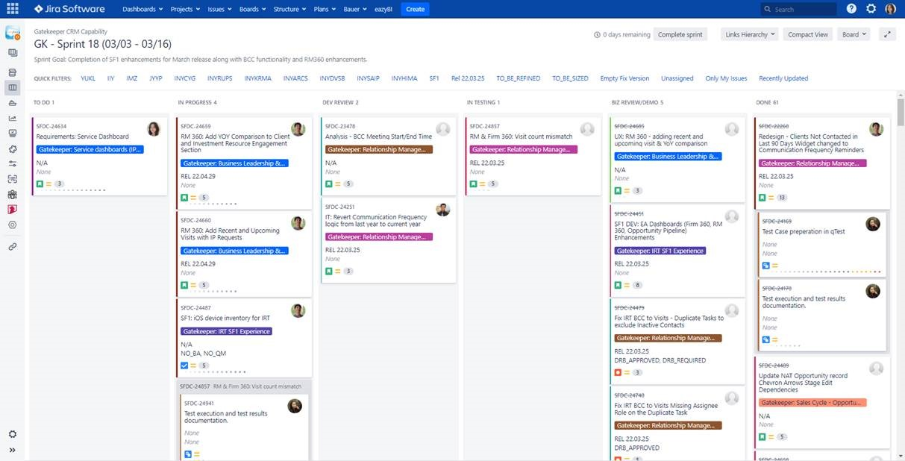
Example Scrum Board

Slide 65
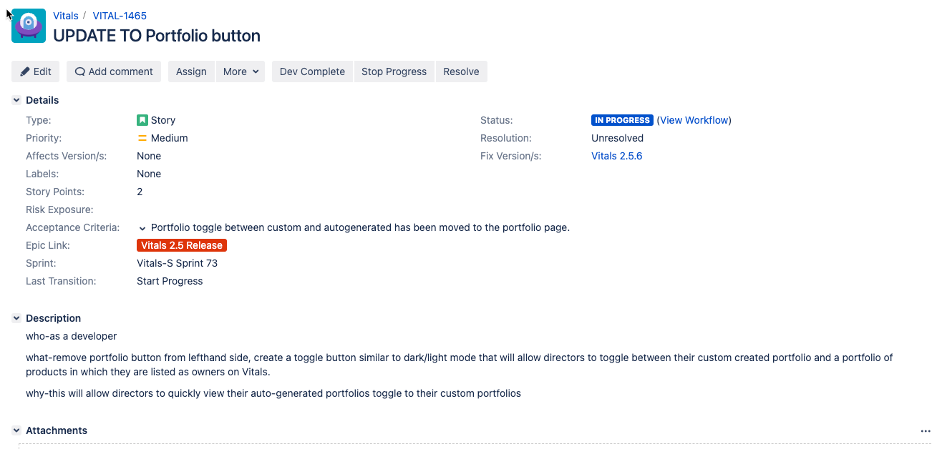
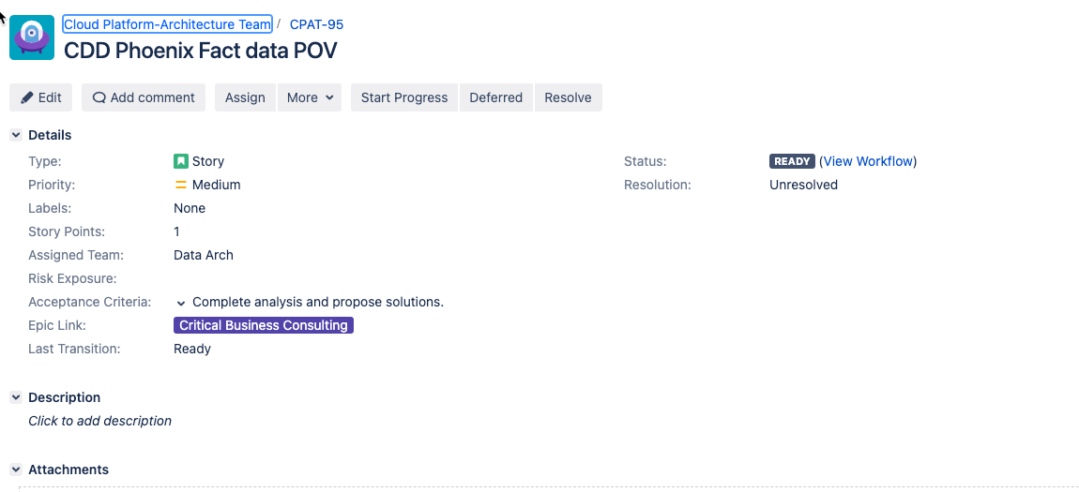
Team Activity – Story Review
Review the two stories displayed here – what are some key differences you see between the two? Which of the two do you think is better structured, and why? For the one less structured, how might you go about correcting it?
Discuss as a breakout room and nominate someone to share your group’s findings.

Slide 66
LAB:
Story description: As a customer of the online ordering system, I want to be able to add new items to my shopping cart, update items already in the cart (e.g., adjust quantities), and remove items from the cart that I no longer wish to purchase so that I can effectively manage and submit an order.
Acceptance criteria: I can add a new item to the cart, I can update quantities on an item that is already in my cart, and I can remove items that I no longer wish to purchase.
Story Points: 13
As a team (in your breakout room), create new stories that break this larger task down into more manageable “bites”. Include description, acceptance criteria, and estimate points for relative level of effort. Also, identify any additional concerns or edge cases that should be considered; capture that information in a card as well.
Breaking down a large story into smaller tasks
Notes:
For adds, what if I attempt to add an item already in the cart – what should happen?
For updates, what if I attempt to reduce quantity to 0 (or some invalid value like a negative number)?
For deletes, what if I remove the last item in my cart?

Slide 67
LAB:
Share your team’s stories with another team in a different breakout room. The other team will examine the stories you’ve created and provide feedback for the following on them.
Is all required detail included? Is anything missing?
With the provided stories, do you feel like you have enough information to successfully complete that feature?
Would you suggest any updates to the story to improve?
Review the number of story points assigned – do you agree with the number? Why or why not, and how would you adjust?
Grooming the backlog
Notes:
For adds, what if I attempt to add an item already in the cart – what should happen?
For updates, what if I attempt to reduce quantity to 0 (or some invalid value like a negative number)?
For deletes, what if I remove the last item in my cart?

Slide 68
Introduction to DevSecOps

Slide 69
“Shift Left” Testing Approach
DevOps (and its CI/CD automation tools) are all about creating trust – in the tools and processes, and in the code itself. Key to this is testing.
A popular movement in DevOps is called “shift left” testing. It is an approach to software testing and system testing in which testing is performed earlier in the lifecycle (i.e., moved left on the project timeline)
This means developers are getting involved more in testing.
A common tradeoff to examine here: How long does a full set of tests take? How often are devs checking code into the branch that is tested? Do the tests take so long that code changes are getting backlogged? How to we prioritize tests in this situation?

Slide 70
Common Security Attacks
Denial of Service (DoS or DDos)
SQL injection
Large files
Cross Site Scripting (XSS)
Credential stuffing

Slide 71
Denial of Service (DoS)
Server “flooded” with so much bogus traffic that systems are unable to serve valid requests
Alternatively, instruction(s) received that trigger a server or system “crash”

Slide 72
Denial of Service (DoS)
Common flooding attacks:
Buffer overflow (most common type)
ICMP flood (AKA “smurf attack” or “ping of death”)
SYN flood
Notes:
Buffer overflow attacks – the concept is to send more traffic to a network address than the programmers have built the system to handle
ICMP flood – leverages misconfigured network devices by sending spoofed packets that ping every computer on the targeted network, instead of just one specific machine; the network is then triggered to amplify the traffic
SYN flood – sends a request to connect to a server, but never completes the handshake; continues until all open ports are saturated with requests and none are available for legitimate users to connect to
Client requests connection by sending SYN (synchronize) message to the server
Server acknowledges by sending SYN-ACK (synchronize-acknowledge) message back to the client
Client responds with an ACK (acknowledge) message, and the connection is established

Slide 73
Denial of Service (DoS)
Crash attacks:
Often involves send of data targeting common classes of bug
Request used to crash or severely destabilize the system

Slide 74
Distributed Denial of Service (DDoS)
Similar profile as DoS but uses multiple systems to orchestrate the attack
Provides attacker with advantages

Slide 75
Distributed Denial of Service (DDoS)
Potential advantages for attacker:
More agents means more power behind the attack
Location of attack is difficult to detect (often globally-routed)
Easier to shut down a single attack machine than multiple
Identity of attacker is more easily disguised

Slide 76
Defending Against Denial of Service
Ensure service has good AuthN/AuthZ in place
Utilize a proxy or gateway and configure throttling
In Production, disable ICMP pings or use rate-limit for ICMP requests (e.g., using iptables)
Notes:
ICMP = Internet Control Message Protocol

Slide 77
Knowledge Check
When we shift left in Devops, what exactly is being shifted left?
Planning
Testing
Deploying
Enter the letter corresponding to your answer in chat

Slide 78
DEMO:
Denial of Service

Slide 79
SQL Injection
Attacker injects SQL (Structured Query Language) queries into app flow (e.g., UI)
In some cases, injected SQL used to retrieve additional sensitive detail
In other cases, injected SQL used to alter or damage a company’s critical data

Slide 80
Types of SQL Injection Attack
In-band
Blind

Slide 81
In-band SQL Injection
Uses existing channel of communication for an attack
Error-based – attacker performs actions that cause errors in order to gather “intel” about database structure
Union-based – attacker takes advantage of UNION SQL operator to fuse multiple SELECT statements into single response

Slide 82
Blind SQL Injection
Attacker sends separate, independent data queries to a server
Called blind because results of query are not sent back to attacker
Instead, attacker observes results to infer vulnerabilities

Slide 83
Blind SQL Injection
Relies on response and behavior patterns of server so slower to execute
Boolean – attacker sends SQL query to database and determines if attack valid based on response received (true or false)
Time-based – attacker sends SQL query to database and determines if attack valid based on amount of time taken to process

Slide 84
Defending Against SQL Injection
Use well-defined contracts to explicitly map expected results from application
Sanitize inputs and use parameterized queries in code
Use a Web Application Firewall that includes protections at the application layer (including protection against SQL Injection)

Slide 85
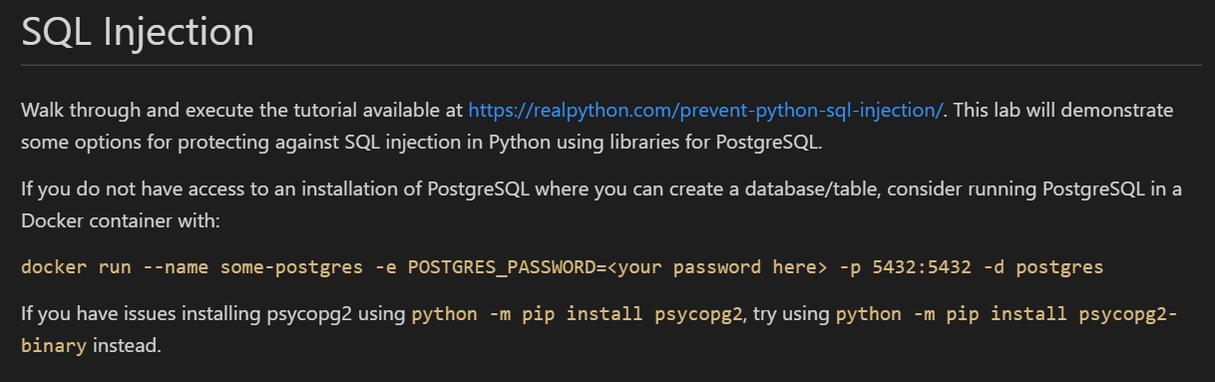
LAB:
SQL Injection
Notes:
Could also run as demo instead (if issues with associate access to PostgreSQL). Alternatively, could create a version in the cloud if associates can access.

Slide 86
Large Files
Sometimes resembles another form of Denial of Service
Attacker attempts to send one (or several) very large files as upload
Could also occur with extremely large payloads (JSON or XML bodies)
As a result, network connectivity to servers or services can become “clogged”

Slide 87
Defending Against Large Files
Use configuration to limit file/payload sizes and number of concurrent connections from a client
Utilize timeouts judiciously to prevent large file operations from completing
Can also leverage MIME types as a way to limit acceptable types of data
Finally, proxies or gateways (WAF) can be configured for mitigation at the network layer

Slide 88
Cross Site Scripting (XSS)
A type of injection – but script instead of SQL
Attacker uses inputs to attempt injection of a <script>…</script> element
An example could be posting a comment with a link that routes to a malicious site

Slide 89
Cross Site Scripting (XSS)
Without inspection for malicious content, <script> can be returned (and executed) in user’s browser
Malicious content can include JavaScript, HTML, Flash, etc.
Really, any code that browser can execute

Slide 90
Cross Site Scripting (XSS)
Common forms of attack:
Stealing cookie or session information
Redirects to web content controlled by an attacker
Executing malicious operations on user’s machine
Leveraging impersonation for elevated privilege

Slide 91
Cross Site Scripting (XSS)
Stored XSS attacks:
Injected script permanently stored on target servers
Could include storage in database, forum, comment field, etc.
Malicious script returned to browser as part of retrieval from storage
Notes:
On a profile page (social media), attacker applies script to one of their profile settings; victim visits profile page for that user, malicious code pulled from storage and executed – for example, redirecting to a malicious site where credentials can be stolen

Slide 92
Cross Site Scripting (XSS)
Reflected XSS attacks:
Malicious script is indirectly transferred back to browser
When user clicks on malicious link, code gets injected into vulnerable site
Malicious code then reflected back to user under the cover of “valid” site interaction for immediate execution
Notes:
For example, attacker sends link to victim which includes a path to a search sight with search terms in query string that is malicious code; victim clicks link and it reflects back the malicious code for immediate execution

Slide 93
Cross Site Scripting (XSS)
DOM-based XSS attacks:
Takes advantage of sites that copy input to DOM without validation
Similar to reflected in that victim is tricked into sending malicious code to vulnerable site
However, input lands in DOM in the browser for execution instead of being reflected back
Notes:
For example, a site that takes query string input and writes dynamically to an element in the DOM (for execution by the browser)

Slide 94
Defending Against Cross Site Scripting
Encode and validate everywhere – do not trust user inputs, escape outputs, and manage response headers
Use libraries with utility handlers where possible (e.g., Jinja or Django)
Quote every attribute of every tag in HTML

Slide 95
Defending Against Cross Site Scripting
Use HttpOnly directive on custom cookie response headers (i.e., “Set-Cookie” header)
Use the “X-Content-Type-Options: nosniff” to prevent MIME type sniffing (i.e., dynamic changes to Content-Type header)
Leverage network components like WAF with built-in protection to intersect at the network layer
https://cheatsheetseries.owasp.org/cheatsheets/Cross_Site_Scripting_Prevention_Cheat_Sheet.html
Notes:
HttpOnly default for session cookies, but should also be used for any custom cookies created
X-Content-Type-Options: nosniff is likely default in modern frameworks but confirm

Slide 96
DEMO:
Cross Site Scripting

Slide 97
Credential Stuffing
Attackers use lists of compromised credentials to try and find a breach
Based on assumption that many users reuse same credentials across sites
Uses bots, automation, and scale

Slide 98
Credential Stuffing
Like a brute force attack
However, instead of random strings, uses existing lists of known credentials
Powered by broad availability of compromised info and increasing sophistication of bots & automation
Notes:
More sophisticated bots that simultaneously attempt several logins and appear to originate from different IP addresses

Slide 99
Credential Stuffing
Attacker sets up bot able to attempt login for multiple accounts in parallel
Uses an automated process to test effectiveness
Monitors for breaches and pulls/retains sensitive detail when found
With parallel attempts, often fakes IP addresses to make difficult to trace

Slide 100
Defending Against Credential Stuffing
Leverage MFA (Multi-Factor Authentication)
Use a CAPTCHA (though I hate them!)
Gather details about user devices to create a “fingerprint” for incoming sessions – if same “fingerprint” is logged several times in sequence, block
Notes:
Something the user knows + has
Fingerprint can include things like combo of OS + geolocation + language (gathered via JavaScript)

Slide 101
Defending Against Credential Stuffing
Leverage IP blacklisting
Rate-limit non-residential traffic sources (like public Cloud)
Block headless browsers based on JavaScript calls used
Disallow e-mail addresses as user IDs

Slide 102
Defending Against Credential Stuffing
Use Capital Group’s primary Identity Provider (Okta) – includes built in credential stuffing protection and alerting
Includes additional risk-based authentication that also considers device, location, request rate, etc.

Slide 103
Knowledge Check
Which attack best describes when an attacker uses a bot to login to multiple accounts in parallel?
Credential stuffing
Cross Site Scripting
SQL Injection
Enter the letter corresponding to your answer in chat

Slide 104
Knowledge Check
In which attack does the attacker attempt to “clog” the network
Credential stuffing
Cross Site Scripting
Large files
Enter the letter corresponding to your answer in chat

Slide 105
DevSecOps
What is it?
Discipline that takes into consideration how People, Processes, and Tools Automation combine to ensure we have:
Disciplined build of security into all phases of SDLC
Just-in-time security assessment and testing
Security as a “shared responsibility”
Notes:
Distributes security concerns to all teams using tooling to help automatically fill in gaps in experience or understanding

Slide 106
DevSecOps
Why is it important?
To maintain a competitive advantage:
We need to deliver software quickly
We need that software to have high quality
We need that software to be secure
We want to merge speed & agility with security & quality!
Notes:
Automation with quality assurance built into the pipeline and security applied at each phase

Slide 107
DevSecOps and how can businesses benefit from it?
DevSecOps integrates software development with IT/SEC operations, leveraging automation to shorten the product life-cycle and enable frequent deliveries aligned with the business needs, while ensuring quality
DevSecOps Building Blocks
Impact Levers
Continuous integration
Automated testing and single source code mgmt. system
Speed
Release in days, not months
Continuous delivery
Ability to deliver software when ready
Quality
Enable speed and enhance stability with rigor and confidence
Continuous deployment
One-click release of software to live
Continuous monitoring and autonomic operations
Highly automated IT Operations, including security, vulnerability scanning
Efficiency
Operate in automated environment and focus on high value tasks
Standardized and automated infrastructure mgmt. with built in security
Automate environment with infrastructure-as-a-code (IaC),
Security
Baked-in and fully integrated into SDLC

Slide 108

Security in Software Engineering – The Traditional Way
Not enough time in schedule to absorb changes required to remediate
Activities required to remediate may be complex
Security issues require revisit of one or more previous phases
Release
Plan
Operate
Test
Develop
Feedback

Slide 109
Security in Software Engineering – A Better Way
Release
Plan
Operate
Test
Develop
Feedback

Slide 110
Security in Software Engineering – DevSecOps
Additional security-specific scanning, port scans, and log validation
Threat modeling, data protection, and risk assessment
Release
Plan
Operate
Test
Develop
Monitoring & alerting, RCA (Root Cause Analysis)
Feedback
SAST (Static Application Security Testing) and SCA (Software Composition Analysis) tooling
DAST (Dynamic Application Security Testing) tooling

Slide 111

Security in Software Engineering – DevSecOps
Information gathered from early phases feed into later phases
In true DevOps fashion, lessons learned feed continuous improvement
Release
Plan
Operate
Test
Develop
Feedback
Quality gates guard against moving security defects forward

Slide 112
Assessing Security Risks (Plan Phase)
To secure a solution, attack surfaces and potential threats must be identified
Common practice utilizes something called threat modeling
Includes modeling and analyzing possible attack vectors based on application

Slide 113
Assessing Security Risks
Risk assessment should account for different “zones” of execution
Security requirements must be understood in context of specific use cases
Ideally, threat modeling would be executed during design & dev phases
Hardware
Software
Network
Database

Slide 114
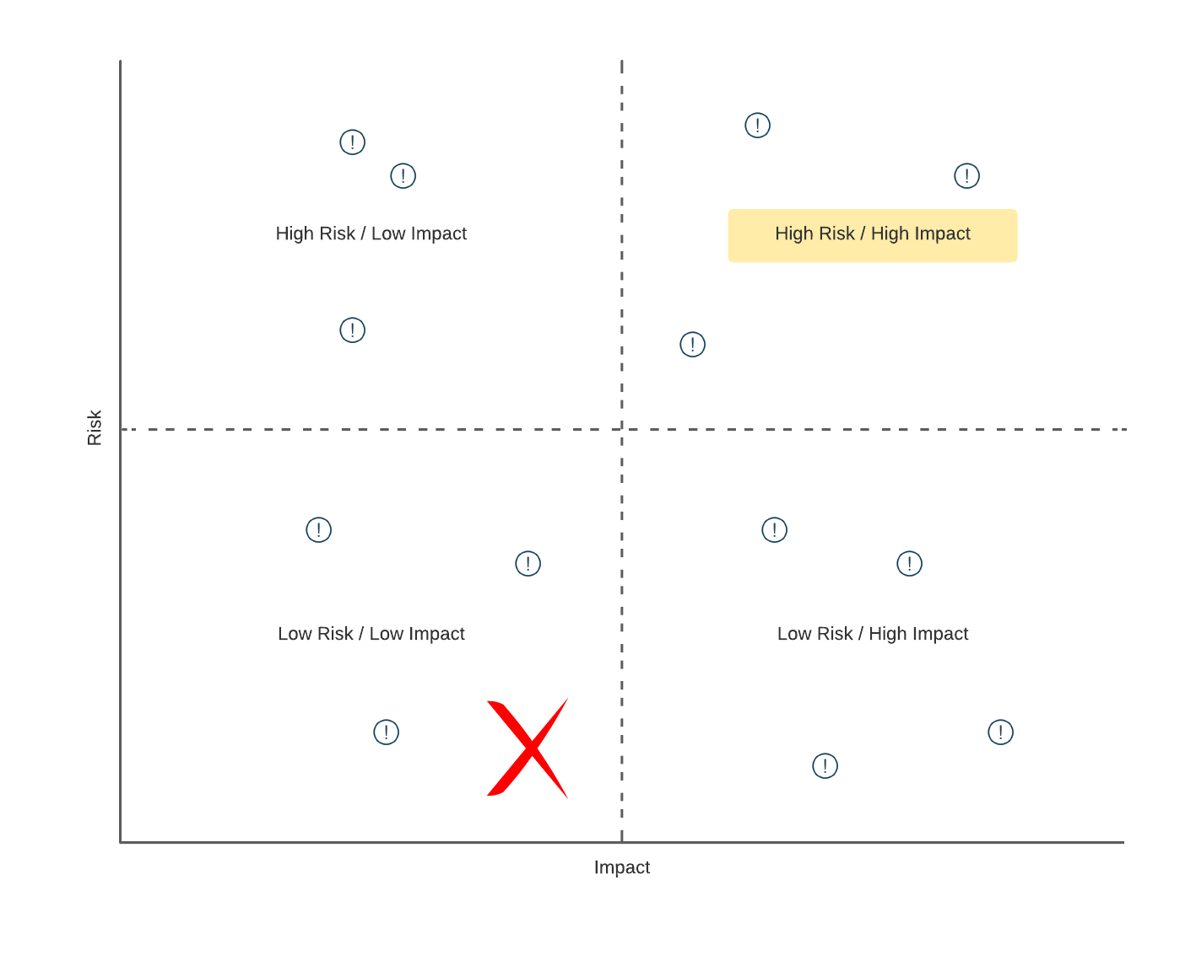
Threat Modeling

Slide 115
Threat Modeling
Can be viewed in two different, but related, contexts:
Implementation of controls mapped to security requirements & policy (prevention)
Implementation of countermeasures against possible known attacks (remediation)

Slide 116
LAB:
Take a look at the telecommunications reference architecture described at https://github.com/chanakaudaya/solution-architecture-patterns/blob/master/industry-specific/Telecommunication-reference-architecture-pattern.md#adding-value-to-your-subscriber-base.
In your assigned breakout room, spend time discussing and documenting potential threats and attack vectors that you see in the defined architecture. Start by brainstorming as many potential attacks as you can think of. Then, as a team, organize by risk vs. impact.
Threat Modeling
Do not worry about being too technical in your descriptions - you are simply looking to think about and identify potential threats by type. Don't forget to include the following considerations:
Hardware
Software
Data
Network
Nominate someone from your breakout room to gather/document the results of the discussion. That person will present to the larger group when we come back together from our sub-teams.
Notes:
May need a less-advanced reference architecture.

Slide 117
Threat Modeling
Multiple approaches:
Attacker-centric (think like an attacker!)
Asset-centric (what do we have to lose?)
Application-centric (what are we building & testing?)

Slide 118
Threat Modeling – Key Considerations
Valuable principles:
Defense in Depth
Principle of Least Privilege
Secure by Default

Slide 119

Shifting Security Left – Develop
Ideally, security flaws in code would be caught on a developer’s machine
Can use plugins for IDEs to provide automated static analysis
In some cases, tools can be configured with custom rules and priorities

Slide 120
Shifting Security Left – Develop
Rulesets and priorities should be driven by results of threat modeling
Scanning tools if used should be a standard part of all developer’s code tooling, to ensure consistently applied (standard dev build)
Goal is to catch issues VERY early on in the SDLC

Slide 121

Moment of Reflection
What is the most “secure” programming language in use in the industry today?
Type your answer in chat
Notes:
https://www.whitesourcesoftware.com/most-secure-programming-languages/

Slide 122
Shifting Security Left – Build
Changes from a developer are ready to be integrated with others
Typically driven through submission of Pull Request in GitHub
Notifies a peer that changes are pending and need review

Slide 123
Shifting Security Left – Build
In addition to logic/syntax errors, peer reviewer can focus on areas of high risk/high impact identified in threat modeling
In some cases, a specialist peer reviewer (e.g., one from InfoSec) can be engaged to validate security of code

Slide 124
Shifting Security Left – Build
Coupled with manual review, SAST (Static Application Security Testing) tools can be integrated into CI/CD to automate security checks
Tools like SonarCloud/SonarQube can be integrated into pipeline via plugins (https://sonarcloud.io/)
Some even include ability to capture scan results in resulting build report and use results of scan as quality gate to prevent move forward on failure

Slide 125
Shifting Security Left – Build
SCA (Software Composition Analysis) tools also provide benefit
Tools like Nexus Sonatype (https://www.sonatype.com/products/open-source-security-dependency-management) can be integrated into CI/CD for automated security scans of Open-Source components
Ideally, governance would be in place to monitor and manage “accepted” set and versions of Open-Source tools approved for usage
Notes:
Like an artifact repository – e.g., npm modules, Docker images, Python packages, etc.
Developers and builds would pull from these repositories instead of the Internet

Slide 126
Shifting Security Left – Build
SCA tools can provide a couple of benefits
Primarily, security scans can be executed, and Open-Source vulnerabilities identified
Secondarily, can help an organization catalog the Open-Source components (and versions) “in play” already

Slide 127
Shifting Security Left – Build
Resulting report can be used to identify components that have not been properly vetted through governance
Results can be merged with overall build output
Quality gates (manual or automated) can be built around results to prevent move forward if insecure

Slide 128
Moment of Reflection
Answer the following question: Using an open-source library is more secure than building something custom? Yes or no, and why.
Type your answer in chat

Slide 129
Shifting Security Left – Test
Includes changes ready for move to QA for additional testing
Dynamic Application Security Testing (DAST) tools provide more sophisticated vulnerability checks
Dynamically exercise application’s runtime interfaces using injected data

Slide 130
Shifting Security Left – Test
DAST tools can use complex combinations of invalid input via fuzzing
Provides multiple layers of protection
A tool like OWASP Zed Proxy or OWASP ZAP is an example (https://www.zaproxy.org/)

Slide 131
Shifting Security Left – Test
Two types – passive scan and active scan
Passive scan less aggressive and minimizes use of fuzzing
As a result, not as robust in its ability to find exposure but also takes less time to run

Slide 132
Shifting Security Left – Test
Because of that, passive scan can be good fit for CI/CD pipelines, especially those that look to push updates at a greater frequency
For the C (continuous) part, need flows to complete quickly
Notes:
Quickly is relative

Slide 133
Shifting Security Left – Test
Active scans are more aggressive in their attack approach
Make extensive use of fuzzing to elevate level of attack sophistication
Send multiple requests, continually altering request data to simulate attack payloads

Slide 134
Shifting Security Left – Test
Can also make use of a technique called “spidering”
Allows the scan to crawl a site or service to simulate sequenced or multi-level attacks (stateful attacks)
Can be very effective in securing a site or service but also takes much longer to execute (due to added complexity and sophistication)

Slide 135
Shifting Security Left – Test
Because of its more aggressive nature, should only be executed against owned sites and in a sandboxed environment (risky)
Often active scans are scheduled to occur out-of-band on a regular basis (weekly, nightly, etc.)

Slide 136
Shifting Security Left – Test
In addition to the automated scans, traditional functional test scripts and manual testing may be used
Should include security-focused testing as well (or in separate PEN testing)
Tests should be informed by prioritized set of vulnerabilities identified during threat modeling

Slide 137
Moment of Reflection
Which type of dynamic scan (passive or active) is more effective, and why?
Type your answer in chat

Slide 138
Shifting Security Left – Release
Software confirmed ready for release
Often deployed to a pre-prod environment (like staging)
Can include automated “smoke” testing

Slide 139
Shifting Security Left – Release
This phase may also include security-specific scans as a “last mile” protection
SAST, SCA, and DAST scans may be repeated in this environment as a double-check
Port scans can also be used (depending on how closely this env matches prod) to help validate exposure at network communication layer

Slide 140
Shifting Security Left – Release
Additionally, this stage can utilize application logging as a type of validation
Provides a unique opportunity to confirm correct sanitization of log detail
Also, can include verification of specific AuthN/AuthZ controls prior to a prod release

Slide 141
Moment of Reflection
What other types of security checks (besides rerunning SAST, SCA, and DAST scans) are effective as part of the Release phase?
Type your answer in chat

Slide 142
Shifting Security Left – Operate
In this stage, monitoring and alerting become paramount for capturing and notifying support of any security exposure “in the wild”
System logs, telemetry, and event detail become useful
Likely not everything will be found prior – ongoing vigilance is a must

Slide 143
Shifting Security Left – Operate
When (not if) something happens, Root Cause Analysis (RCA) is important
Helps with understanding the why
Can also help with identifying short-term workarounds (to stop the bleeding) and long-term fixes (for enhancement prioritization)

Slide 144
Shifting Security Left – Operate
Preceding detail can feed dashboards or reports to help stakeholders visualize the security posture of the system and org
System logs can also be used to satisfy auditing requirements (depending on the industry)
Key Performance Indicators (KPIs) can be used to measure

Slide 145
Shifting Security Left – Operate
Examples
Number of security-related tickets
Build or release delays caused by security alerts
Mean time to compliance
These can all help support the Continuous Improvement function in the area of security focus

Slide 146
Shifting Security Left – Operate
One additional layer of protection that a company can employ involves security bug “bounty hunters”
Ethical hackers that can be paid to independently attempt to attack a site or system
Can result in a set of reports on uncovered vulnerabilities and recommended remediations
A SIEM (Security Information and Event Management) solution can also help with detection, analysis, and response

Slide 147
Moment of Reflection
What is one Key Performance Indicator (KPI) or metric you would recommend using (or have used) to evaluate the security posture of a system running in production?
Type your answer in chat

Slide 148
Other Key Considerations - SAST
Be aware that SAST tools have the propensity for false positives (depending on tooling employed)
Tools may err on the side of caution with security scans
Might require that an organization customize the tool to more accurately report on environment and application
Otherwise, teams run the risk of wasting time on non-value add activities, impeding “frictionless security”

Slide 149
Other Key Considerations - Containers
If application profile includes containers or container orchestration (k8s), additional consideration required relative to security of images
Tools like Aqua (https://www.aquasec.com/) and Prisma Cloud (https://docs.paloaltonetworks.com/prisma/prisma-cloud/) can help with scanning of container images

Slide 150
Other Key Considerations – Sensitive Config
Sensitive configuration data and app secrets (e.g., connection strings, passwords, etc.) should never be hardcoded in source
Run the risk of checking into and exposing via source control
Tools like truffleHog (https://github.com/dxa4481/truffleHog/) can help with GitHub repo scanning

Slide 151
Other Key Considerations – Sensitive Config
Other platforms include built-in support
Services like AWS KMS or Azure Key Vault can provide dynamic linking of secure config into the CI/CD pipeline

Slide 152

DevSecOps
Potential Benefits
Security “baked” into the process end-to-end
Promotes secure by design and defense in depth
Increased efficiency in verifying security through automation
Faster recovery times if security breach occurs
Enables measurement and objective assessment of security posture

Slide 153
DevSecOps
Potential Benefits
Leveraging established Capital Group best practices, existing reference architectures, and existing patterns helps minimize risk
Also, helps ensure you meet critical security requirements in a “low friction” manner
Means as a developer you don’t have to try to mitigate all threats on your own – there are resources available to assist

Slide 154
DevSecOps
Potential Issues
Knowledge gaps about security, a complex subject
Additional complexity and friction in pipeline
Potential for developer overload
False positives breed “noise” and can lead to “boy who cried wolf”

Slide 155
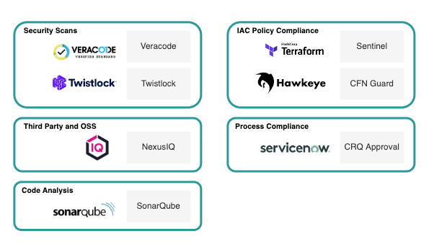
LAB:
Review the Capital Group DevSecOps Toolset
Google each of the tools above used at Capital Group. Create a 2 – 3 sentence description for each based on the results of your research.

Slide 156
Where Can I Go For Help?

Slide 157
Introduction to Test-Driven Development (TDD)

Slide 158
Benefits to be experienced with automated testing
Greater shared success
(as tests can be tied to requirements)
Cleaner code
Guaranteed system documentation
Improved quality
Reduced fear
Improved regression protection
Greater streamlining to the approach
(small bites, avoidance of premature optimization, structured flow)
Discussion | Which of these benefits resonate most with you?
Notes:
Clean code means
- Loosely-coupled
- Well architected
- Testable
- Maintainable
- Stable
- Quality & performant
You pass the tests, you meet the requirements

Slide 159
Balancing Speed & Quality
Speed
Regulatory Compliance
Business Agility
Security
Quality
We want to move quickly to maintain a competitive advantage & increase profitability
We want to move safely to ensure we minimize rework cost & prevent monetary & reputational damage

Slide 160
What if we wrote our tests first?
Test Driven Development reverses the usual
Devs must devise a test that will verify correct operation of a function before they even write the function
This forces you to write functions that “do one thing, and do it well”
Notes:
INSTRUCTOR NOTES:
REVIEWER COMMENTS:
PB: Question: When should you consider Test Driven Development?

Slide 161
Test Driven Development – basic sequence
Write a unit test for the function you’re about to create
Run the test – it should fail
Write the function
Test it
If it fails, re-examine your test and change it if your logic was wrong
Otherwise, refactor your function until it passes
Write another test - repeat
Notes:
INSTRUCTOR NOTES:
REVIEWER COMMENTS:

Slide 162
Test-Driven Development (TDD) and the 3 Laws
1
2
3
The First Law
The Second Law
The Third Law
“You are not allowed to write any production code until you have written a unit test that fails due to its absence”
“You are not allowed to write more of a unit test than is sufficient to fail, and failing to compile is failing”
“You are not allowed to write more production code than is sufficient to cause the currently failing test to pass”

Slide 163
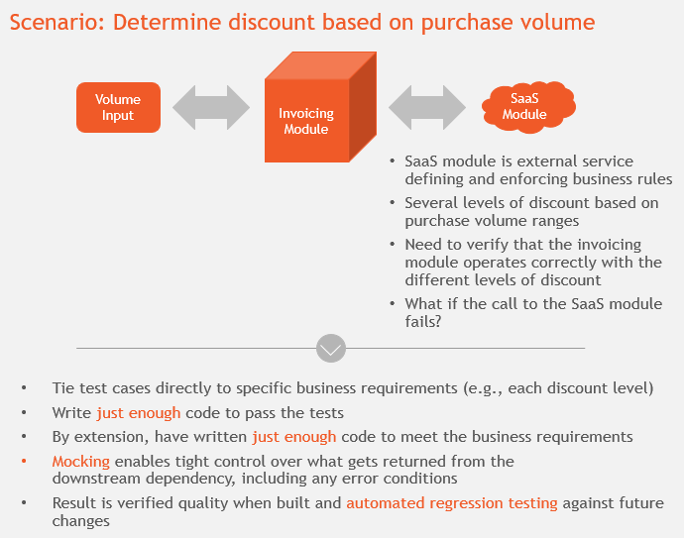
Understanding TDD
Notes:
For example:
- Purchase 1000+, discount of 20%
- Purchase 500 – 999, discount of 15%
- Purchase 100 – 499, discount of 10%
- Purchase < 100, no discount
Just enough is important – code is expensive to create and maintain. We should seek to minimize the code we write because it helps minimize the set of things that could go wrong.
Mocking – able to "force" the return of each level of discount to validate how invoicing operates; also able to "force" the return of an error to test error handling. Without mocking, you would have to ensure all necessary test data and conditions are in place to ensure return of what you need for your test as part of an end-to-end call. Probably not possible is SaaS module is owned by a third party.
With automated regression testing, as the invoicing module grows and changes, you'll be able to quickly see any resulting breaks at the push of a button.

Slide 164
Best practices with TDD
TDD supports the following best practices:
Don’t commit to a methodology, commit to impact and a positive result
Ensure that the engineering team has a clear understanding (and practice) for unit vs. integration testing
Automated test code is code – just like application code – estimate and plan accordingly
Find the right % of test coverage – quality & quantity!
Notes:
We’ll talk more about code coverage shortly

Slide 165
To be effective, automated unit tests need to follow FIRST:
F
I
R
S
T
Fast
Independent
Repeatable
Self-validating
Timely
or they won’t be executed
i.e., minimal dependencies between tests (keeps them simpler)
i.e., every run against unchanged code should operate the same
i.e., Boolean output (pass or fail)
if not first, early and often
Notes:
In “Clean Code”
Fast or they won’t get run
Independent – no dependence between tests
Repeatable – every run should operate the same every time
Self-validating – Boolean output (either pass or fail); single logical assert
Timely – if not first, early on

Slide 166
Challenges
What are some of the challenges you face with software testing in your jobs (i.e., why don’t we test as much as we want to or should)?
Notes:
Open discussion – notate responses

Slide 167
Challenges
Time pressures
Complexity
Requires more code
More debugging (up front)
More cost (up front)
“Can’t we just ensure quality with other types of testing?”
Notes:
More code can = more debugging, more cost, etc.
Bugs become costlier to fix the later in the development lifecycle
Effective software development requires multiple types of testing – all are important

Slide 168
Knowledge Check
Which of the following best describes TDD?
Write tests before writing code
Write higher quality tests
Write more tests
Enter the letter corresponding to your answer in chat

Slide 169
Knowledge Check
Why do we first write a failing test in TDD? Why not a passing test instead?
Type your answers in chat
Notes:
Answer: We never trust a test that doesn’t fail. Ie - a failing test proves that the test is doing it’s job - of ensuring quality. If our tests always pass then they are not effective - they have to tell us something is wrong with our code, and they can only do that when they fail…

Slide 170
Testing Strategies

Slide 171
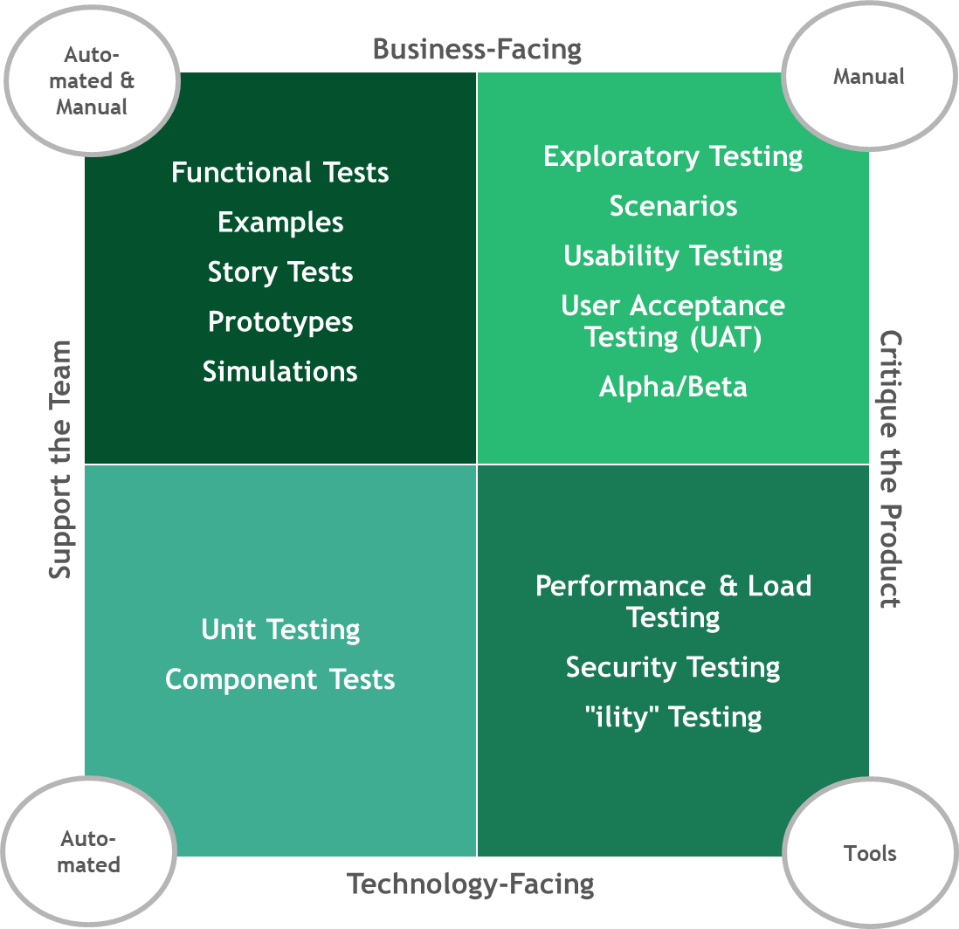
Using the Agile Testing Quadrant
Source - https://lisacrispin.com/2011/11/08/using-the-agile-testing-quadrants/

Slide 172
Testing Quadrant
Business Facing
Confirm the external quality of the product
Critique the Product
Support the Team
Focused on evaluating overall product quality
How will software that meets the functional requirements perform (on multiple levels) when deployed to production?
Ensuring that Quality of Service (QoS) are met
Focused on supporting the teams that underpin the product & its delivery
Goal is to help guide the quality of the product & prevent functional defects from making their way into production
Technology Facing
Source - https://lisacrispin.com/2011/11/08/using-the-agile-testing-quadrants/
Maintain the internal quality of the application
Notes:
Ryan will talk about one of the goals being to free up teams' capacity by leveraging test automation, so they have time to focus on tests for important Quality-of-Service (non-functional) testing.
Many teams are so focused and fully consumed with manual testing that many other non-functional and critical test phases are neglected: exploratory, performance, cross-browser/platform, UAT, A/B, security, stability, scalability, etc.
Implementing test automation frees up capacity from the QA team to perform these exercises, which can often find those hard-to-identify defects before they reach production.

Slide 173
At times, without vigilance, we may find that our software testing resembles an ice cream cone rather than a pyramid
Automated E2E Tests
Integration Tests
Unit Tests
Source - https://alisterbscott.com/kb/testing-pyramids/

Slide 174
Test Pyramid
Speed
Cost
Automated
E2E Tests
Integration Tests
Unit Tests
Source - https://martinfowler.com/bliki/TestPyramid.html
Notes:
Multiple other types of testing - load testing, integration test, E2E integration testing (in Capital, 100's of systems - any large program, can impact 20 - 50 investment systems; every product team does testing of their "part" but there's significant integration testing). Test automation - used for functional, performance, regression testing vs. more archaic manual testing. More brittle as you move up the pyramid, takes longer/more expensive. Shift left.

Slide 175
Test Pyramid
Automated
E2E Tests
Test functionality from the perspective of the person using the app
Integration Tests
Test multiple functions together to verify coordinated bundles of logic
Unit Tests
Test discrete units of code in isolation from others
Source - https://martinfowler.com/bliki/TestPyramid.html

Slide 176
Test Pyramid
Speed
Cost
Automated
E2E Tests
Indicates how quickly the different test types are expected to execute
Integration Tests
Indicates how costly the execution of each type of test is expected to be (over time)
Unit Tests
Source - https://martinfowler.com/bliki/TestPyramid.html

Slide 177
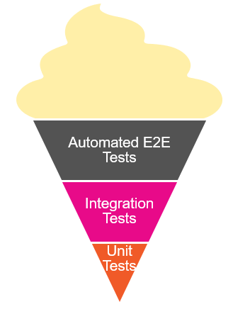
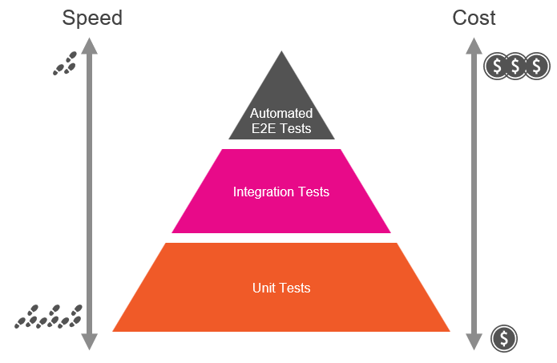
Reflection
What are some of the root causes that you think could cause a shift from the pyramid to the ice cream cone?
During project execution, what are some specific warning signs we can look for that will alert us to a trend towards that shift?
What are some practical steps we can take to move from the ice cream cone to a proper testing pyramid?

Slide 178
Managing Software Quality

Slide 179
Using Test Coverage to evaluate the completeness & effectiveness of our tests
The What
The How
Measurement mechanisms are built into many languages & development frameworks
These tools analyze source code under test against automated test runs, identifying source code that is covered (exercised by one or more tests) vs. not covered (excluded from any test)
Ranges from 0 – 100%, and the higher the number, the better the coverage
A low test coverage percentage indicates a deficiency in automated testing
Test coverage measures are often integrated into CI/CD pipelines, failing the build if a minimum level of coverage has not been achieved
Discussion | What is the “correct” target percentage for unit test coverage?
Notes:
In presentation, talk about 80/20 rule – not just about the number but about focus on what's most important. 20% of the code often causes 80% of the bugs. Focus on testing what's most critical – not just quantity but also quality.

Slide 180
Wrangling “Technical Debt”
Tactics to mitigate technical debt:
Find opportunities to pay down debt as part of a future enhancement
Remove debt when modernizing a legacy system – don’t simply do a “balance transfer” when building the replacement
Embrace pay down of technical debt as a regularly-planned activity within your sprints (if possible)
Involves borrowing from the future to address the immediate
Manifests as choosing to go with a sub-optimal solution to move a project forward, instead of spending the time to build out the optimal approach
Results in higher compounding costs in the long-run (e.g., future development cost, long-term maintainability, speed, quality, etc.)
20-30%
of sprint capacity, ideally, should be allocated for bug fixes, automation improvement, POCs, etc.

Slide 181
End-to-End (E2E) Automated Tests
Everyone owns quality – quality from start to finish
Integration testing – system level, point-to-point interface testing
Testing across multiple products critical as well
At Capital Group, there are hundreds of systems – any large program change can potentially impact 20 – 50 investment systems
Critical that this be automated to verify quality of external/customer user experience across our systems

Slide 182
Unit Testing Frameworks
Notes:
INSTRUCTOR NOTES:
REVIEWER COMMENTS:

Slide 183
Purpose of a unit testing framework
Help you write and run unit test
Provide test reporting
Manage collections of unit tests
Implement testing strategies that vary according to testing needs
Notes:
INSTRUCTOR NOTES:
REVIEWER COMMENTS:

Slide 184
Popular unit testing frameworks for Python
PyTest
Robot
Unittest (we will use this for our work)
DocTest
Nose2
Notes:
INSTRUCTOR NOTES:
REVIEWER COMMENTS:

Slide 185
Where does a unit test come in the development cycle?
VERY IMPORTANT FACT: Unit tests are NOT executed on a running instance of your application. They are run using ONLY your source code
This means they can be run before you use valuable resources to build and deploy your app, catching problems early
Notes:
INSTRUCTOR NOTES:
REVIEWER COMMENTS:

Slide 186
Writing Unit Tests in UnitTest
Notes:
INSTRUCTOR NOTES:
REVIEWER COMMENTS:

Slide 187
unittest Module
Included in Python standard library
Provides a framework for building and running unit tests against Python code (functions, classes, etc.)
A Python file houses code that will be used to automate the testing

Slide 188
unittest Module
Test code imports unittest and module under test
Test code includes a Python class that inherits from unittest.TestCase
We write Python methods to exercise our business logic and verify expected outputs

Slide 189
unittest Module
unittest includes multiple “assert” methods for checking different kinds of results (expected vs. actual)
Can exercise tests through unittest framework
Results will indicate success (or failure)

Slide 190
unittest Module
Options for executing tests
python -m unittest module_name
python -m unittest module_name.TestClass
python -m unittest module_name.TestClass.test_method
python -m unittest path/to/test_file.py
Can also use “discover” mode by running python -m unittest

Slide 191
unittest Module
If test run fails, could be for 1 of a couple of reasons:
Code under test is incorrect
Test code is incorrect
Verify the expected test results against your requirements
If the expected result aligns, then fix the code under test

Slide 192
unittest Module
Assert methods include:
assertEqual/assertNotEqual
assertTrue/assertFalse
assertIn/assertNotIn
https://docs.python.org/3/library/unittest.html#assert-methods

Slide 193
unittest Module – Setup and Teardown
Rather than repeat common logic across tests, unittest provides a couple of options for capturing:
setUp
tearDown
Includes a couple of forms

Slide 194
unittest Module – Setup and Teardown
At the individual test level:
setUp() – logic executed before each test is run; provides chance to setup common conditions
tearDown() – logic executed after each test is run; provides chance to clean up (keep tests isolated)

Slide 195
unittest Module – Setup and Teardown
At the TestClass level:
setUpClass() – logic executed before any tests in a class are run; requires decoration as a class method
tearDownClass() – logic executed after all tests in a class are run; requires decoration as a class method

Slide 196
unittest Module – Skipping Tests
While permanently skipping tests can be a “smell”, unittest offers options for temporarily skipping:
@unittest.skip() decorator
@unittest.skipIf() decorator
@unittest.skipUnless() decorator
self.skipTest method – call within test to initiate a skip

Slide 197
Mocking – Testing Components in Isolation

Slide 198
Mocking / Test Doubles
We use mocking/test doubles:
To help isolate our testing to focused areas of code
To manage dependencies and help control testing against them
To force special cases that exercise specific code flows
To bring stability and consistency to our tests
Helps make the “unit” in unit testing possible
Notes:
Often use the term “mocking” but the concept is more nuanced
We want to be able to setup conditions that allow us to test in isolation so we can ensure maximum coverage of our code with our tests

Slide 199
Mocking / Test Doubles
Dummies
Fakes
Stubs
Spies
Mocks
Notes:
Maintainable - readable

Slide 200
Dummies
Simplest form of test double
No real functionality – mostly a placeholder
When dependency exists but is not needed for the test
Create and use an empty or straightforward copy
Returns meaningless value on every call

Slide 201
Stubs
Same response regardless of parameters passed
Used to test different paths through code
Allows you to control the value of the dependency
Can also use to force an exception
Create a copy of the dependency and return same value

Slide 202
Spies
Can return a value like a stub
Also provides info about how called
Verify member call with specific parameter values
Verify member call a specific number of times
Verify whether member called or not
Helpful with testing at third party boundaries
Helpful with managing side effects of dependencies

Slide 203
Mocks
Programmable spies
Can return a set value like a spy
Difference is ability to setup test data in the double
Provides additional flexibility - can code the setup
Still only returns set value but it’s the value coded
Trade-off – requires setup work

Slide 204
Fakes
Most powerful type of test double
Acts like the class/component it’s doubling for
Double that’s more sophisticated (but still controlled)
Useful for managing downstream dependencies
Gating database connections
Gating web service calls
File operations
Can appear to integrate but control results
Notes:
Classic example – fake repository that provides hard-coded values instead of requiring a hit to the database

Slide 205
Coverage

Slide 206
Coverage
Coverage in unit testing measures the % of your code under test that is exercised by a unit test
Coverage value can range between 0 and 100 %
Question: What is the right target % of coverage to aim for?

Slide 207
Coverage
coverage.py can be used to measure test coverage in your Python app
Install using pip (pip install coverage)
Use coverage run to measure
For unittest, use coverage run -m unittest <target>

Slide 208
Coverage – Measuring Results
Use coverage report to report coverage results
Alternatively, coverage html can be used to view coverage results in a more user-friendly manner

Slide 209
unittest, Mocking, and coverage - Demo

Slide 210
unittest, Mocking, and coverage - Lab

Slide 211
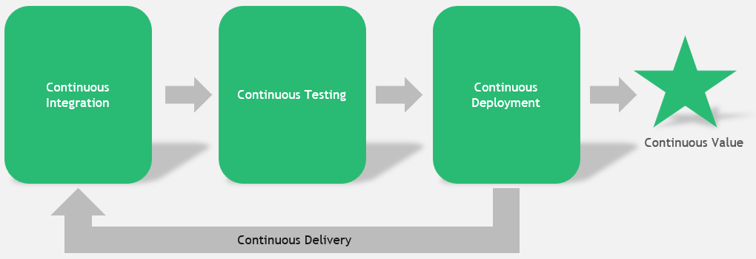
Continuous Testing
Common Types | Description
Unit testing | Testing discrete units of code in isolation from other code (e.g., testing a single method). Leverages mocking to stabilize other system dependencies so that tests are repeatable. Code coverage often used to assess quality & sufficiency of unit testing. Should be automated.
Regression testing | Testing that verifies that newly introduced changes for development of a feature do not inadvertently break other, existing features. Automated unit tests can also fill the role of a regression test suite nicely. Quickly confirming no breakages.
Integration testing | Testing that verifies that groups of components & component features operate correctly when combined with other features (e.g., multiple functions or modules that provide a larger “chunk” of functionality). Usually represents a layer above unit testing but below functional testing. Should be automated.
Functional testing | Testing that verifies functional requirements for critical workflows in the software end-to-end. Can be (and probably should be) implemented as automated black box tests, requiring minimal knowledge & minimal assumptions about the inner workings of the software.
Acceptance testing | Testing that verifies the functionality of the software against specific acceptance criteria defining the difference between “good” & “bad”. May include manual testing/utilization by a subset of testers to verify that the software will operate correctly when leveraged by end users in production. AKA does the software do what it is supposed to from the end user’s perspective?
Security testing | Testing that verifies the functionality of the software against critical security requirements as identified & prioritized via threat modeling. Through a combination of static & dynamic testing, assesses the software for security vulnerabilities or deficiencies from a compliance & regulatory perspective (A.K.A. DevSecOps). Examples include SQL Injection and Cross-Site Scripting.
Performance testing | Testing that verifies that the software will meet defined SLAs (Service Level Agreements) when exercised under load or stress. Can also be used to validate the software’s ability to elastically scale (out or in) based on volumes. How does the software perform under load?

Slide 212
“Shift Left” Testing Approach - Redux
DevOps (and its CI/CD automation tools) are all about creating trust – in the tools and processes, and in the code itself. Key to this is testing.
A popular movement in DevOps is called “shift left” testing. It is an approach to software testing and system testing in which testing is performed earlier in the lifecycle (i.e., moved left on the project timeline)
This means developers are getting involved more in testing.
A common tradeoff to examine here: How long does a full set of tests take? How often are devs checking code into the branch that is tested? Do the tests take so long that code changes are getting backlogged? How to we prioritize tests in this situation?

Slide 213
Distributed Version Control and Git

Slide 214
What is Version Control?
Programs AND work practices that we use to track and control text documents
What documents? Source code - the text files we use to create our executable program
Helps facilitate multiple contributors on a project
Allows us to revert to previous iterations of code base as needed
Notes:
INSTRUCTOR NOTES:
REVIEWER COMMENTS:
PB: Who can give me an example?

Slide 215
The Past: Client/Server Version Control
Prior to 10-15 years ago, most version control used client/server model:
One computer (version control server) had all source code files; it was usually on-site
Client computers (devs) could “check out” a file with the server – that would lock the file to changes
When dev done with work, submits change to server
Once change is made, the file is unlocked for others to modify
Disadvantage: geographically distributed teams weren’t possible; multiple devs can’t work on the same file
Notes:
INSTRUCTOR NOTES:
REVIEWER COMMENTS:

Slide 216
The Present: Distributed Version Control
The source code files are distributed – a full copy of all files, and their entire history, exists on every developers’ computer
Multiple devs can work on the same file simultaneously – when they merge, a computer program will handle routine merge actions; merge conflicts are raised for human interaction
There are a few popular programs:
Subversion
Mercurial
Git
Git is by far the most popular
Notes:
INSTRUCTOR NOTES:
REVIEWER COMMENTS:

Slide 217
Git
What is it?
Open-source distributed version control system
Takes “snapshots” of an application folder as changes occur
Includes both a local and remote component
Changes are local and are synced with remote as needed
Keeps a log of history of changes and allows return to previous version if required
Available at https://git-scm.com/ for download & installation

Slide 218
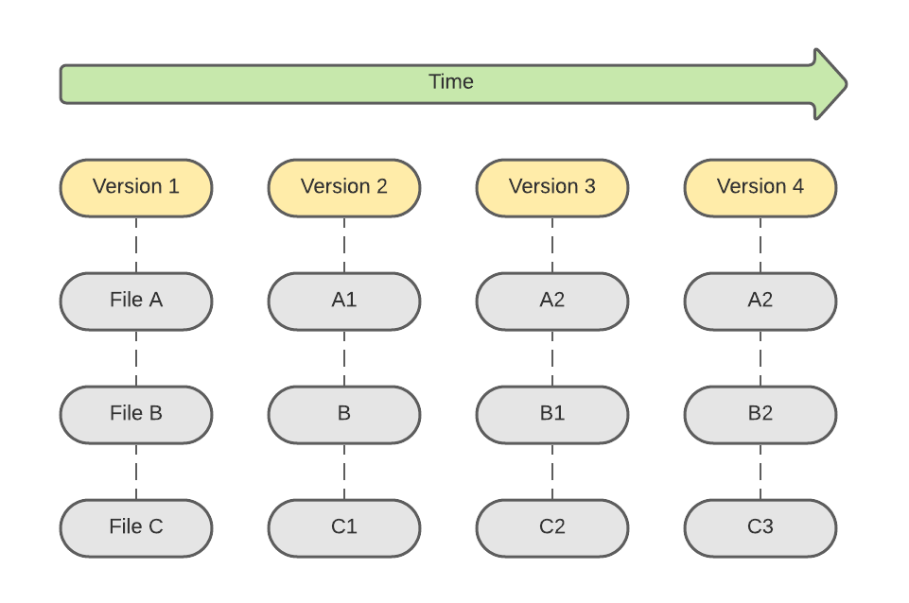
Check-ins Over Time in Git
Other version control systems track a running list of differences in each file over time
Git keeps snapshots of the entire folder at each check-in over time
Uses checksums to verify that contents of snapshot not tampered with

Slide 219
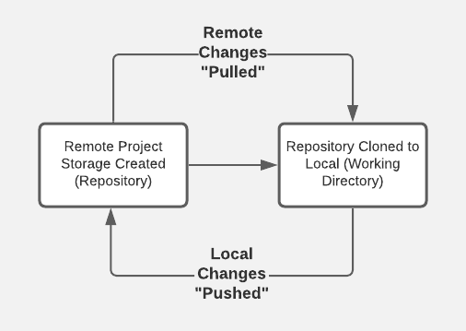
Typical Workflow
Over time, local is refreshed periodically from remote to absorb changes from other devs on the team
3
Remote storage location created (e.g., on github.com)
Branch created locally (or “checked out”) and pushed upstream to remote repo
1
2
4
Over time, changes in local are persisted to remote (checked in); when feature work complete, a PR (Pull Request) is submitted to request merge of branch to mainline
NOTE: Also, able to initiate repo creation from local command-line
Notes:
github.com is a site used to host remote GitHub repositories for access over the Internet; there’s also an Enterprise version that provides storage isolated to an organization

Slide 220
The Three Git States
Staged
File changed
Not yet committed to local database
Includes a short message describing contents of the commit
Persists current snapshot (including staged files) to local database
Modified file marked for inclusion in next commit snapshot
Can be selective about which modifications get staged
Modified
Committed
Notes:
Local database in this case is the .git directory that is available in every Git working directory

Slide 221
Demo
Notes:
Demo will be interweaved with the upcoming slides (toggle between slides & demo)
Demonstrate:
Cloning a repository
Contents (including hidden .git folder)
Talk about .gitignore and purpose – show https://www.toptal.com/developers/gitignore
Creating a new branch
Push branch upstream
Regular pull of updates from remote
`git status`
`git add` (staging)
`git commit` (commit)
Push of local updates to remote
Command-line and VS Code
Demonstrate:
Initiating creation of repo locally from command-line

Slide 222
Configuring Git
git --version to confirm Git is installed and to check version
git config --global user.name “<username>” to set username
git config --global user.email “<email>” to set user email address
File changes will be identified in Git history using this information

Slide 223
Configuring Git
Use git config --list to see all configuration settings
Use git config <setting name> to view a specific setting
For example, git config user.email

Slide 224
Create a Repository
Public or private repository can be created with hosting service (e.g., GitHub)
To link with local snapshot of remote repo, have a couple of options:
Initialize local from command line, add files locally, add/push to remote
Use URL from remote to pull to local via clone

Slide 225
Push to Remote
Create and/or navigate to target folder at local
With an existing repo at hosting provider (e.g., GitHub), execute the following:
echo “# <initial README.md text>” >> README.md
git init
git add README.md
git commit -m “<commit message>”
git remote add origin <HTTPS URL to repository>
git push -u origin main

Slide 226
README.md
echo “# <project title>” >> README.md creates new README file
Usually, a Git repo will include a “markdown” file with info about the repo
Markdown syntax is used to apply formatting characters to raw text

Slide 227
README.md
When displayed in “markdown” reader, formatting is applied
For example, “# “ in the echo statement formats text as a header
One great option for previewing the markdown is using the “Open Preview” feature in Visual Studio Code
Cheat sheet for markdown syntax at https://www.markdownguide.org/cheat-sheet

Slide 228
git init
git init initializes local repo using configuration template
After executing, folder recognized as local Git repository

Slide 229
git add
git add README.md “stages” the README.md file for commit in Git
Reminder – files in Git can be in 1 of 3 stages:
Modified – file changed but not yet staged or committed
Staged – file ready for commit
Committed – file changes persisted to local repo; ready for potential push to remote

Slide 230
git commit
git commit -m “<commit message>” persists staged files to local repo
-m flag used to specify message to attach to current commit snapshot
At this stage, file changes are persisted locally but not yet remotely

Slide 231
git remote add
git remote add origin <HTTPS URL to repository> used to add remote
Configures link between local and remote at hosting provider
If target remote is a private repo, will require additional security
Can use a personal access token (with GitHub)

Slide 232
git push
git push -u origin main used to persist branch and changes to remote
-u used to specify “upstream” (or remote) branch target
origin is reference name for remote repo
main is name of branch to push
Again, if private repo, will require additional security to complete

Slide 233
git clone
For initial pull of repository from remote (e.g., GitHub) to local, use git clone
Create and/or navigate to folder where new repo folder should exist
Format is git clone <HTTPS URL to repository>

Slide 234
git clone
If repo is private, user will need to be granted access
Public repos can be cloned without additional access being granted
Upon completion, new folder will contain local snapshot of remote repo

Slide 235
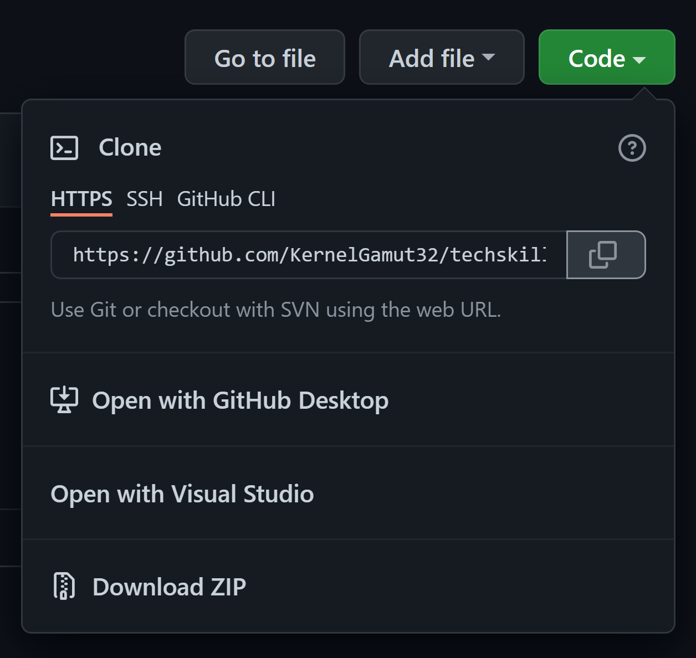
git clone
On repo “home page” in GitHub, clone repository URL can be found/copied using the “Code” dropdown

Slide 236
git pull
Local repository can be refreshed from remote (as required)
Canonical use case is updating local version of shared branch with others’ changes
With branch checked out locally, use git pull origin <branch name> or git pull (which will default to currently checked out branch name)

Slide 237
Lab
Notes:
Creating a new repository in GitHub
Cloning that repository locally
Creating a new repository locally
Pushing that repository to remote
Use https://docs.microsoft.com/en-us/learn/modules/intro-to-git/ + https://docs.microsoft.com/en-us/learn/modules/create-git-project/

Slide 238
Branching in Git
Branches provide segregated snapshots of the codebase for parallel workstreams
Often, branches created from mainline for development of a specific feature
Structured process used to merge branches back into mainline

Slide 239
Branching in Git
Use git checkout –b <branch name> in local working directory to create new branch
Use git push –u origin <branch name> to push branch to remote for tracking
git branch --list used to list existing branches

Slide 240
Branching in Git
git checkout <branch name> used to switch to different local branch
git fetch used to refresh local list with list of newly added remote branches

Slide 241
Making Code Changes
Checkout target branch for development
Make necessary code changes – including adds, updates or deletes
Use git status to see the state of files in the current branch

Slide 242
Making Code Changes
Use git add to stage changes for push to remote
Either git add <filename> or git add –A (for all updates in directory)
Use git status to check status of modified vs. staged artifacts

Slide 243
Making Code Changes
To unstage 1 or more files, use git restore --staged <file or wildcard pattern>
git restore --staged . used to unstage current directory
Use git add to restage

Slide 244
Pushing to Remote
Committed files are pushed to remote using git push
Format is git push origin <branch name> or git push (to push to currently checked out branch in remote)
User will need permissions on repo to push
May be prompted for credentials with hosting provider to complete

Slide 245
Pushing to Remote
To prep staged files for push to remote, use git commit
Format is git commit -m <commit message>
git status will reflect status change

Slide 246
Pull Requests
When feature complete and ready for merge, engineer submits pull request (PR)
Allows peer review of proposed changes
Usually governed by policies around number of required reviewers, successful build in branch before merge, etc.

Slide 247
Lab
Notes:
Creating a new branch on a cloned repository
Making changes to that branch
Pushing those changes to remote
Creating a pull request from those changes
Use https://docs.microsoft.com/en-us/learn/modules/collaborate-with-git/

Slide 248
Merging in Git
Best practice is to favor multiple smaller PRs over a few larger ones
Helps reduce review risk and chances for conflicts
Also, helps to minimize “drift” between in-progress work and mainline
Notes:
Larger PR’s can last longer – over time, mainline is changing from other dev work. Keeping the 2 in sync and moving in smaller steps.

Slide 249
Merging in Git
The larger the PR, the longer it can stay open
Other features are being merged into mainline while development continues
If Git is unable to automatically merge and resolve multiple changes to the same file, results in a conflict

Slide 250
Merging in Git
Good practice to regularly refresh branch with pull from mainline
Helps to keep branch in sync with mainline
Allows developer to find and fix merge conflicts in the branch before submitting PR
Notes:
* Conflicts requiring manual intervention can be addressed before PR submission
* When PR is approved and merged, branch can be deleted

Slide 251
Managing Merge
With target branch checked out, use git merge to pull in updates
For example:
git checkout branch-name
git merge origin main

Slide 252
Managing Merge
Any merge conflicts will be called out on the command-line
Use git status and git diff to list merge conflict details
Manually update files to resolve and push changes to remote

Slide 253
Managing Merge
Once all conflicts have been resolved, run git merge once more
Do a final push to remote for the branch to refresh
To “cancel” merge, use git merge --abort

Slide 254
Managing Merge
Alternatively, many IDEs will help you automatically manage via UI

Slide 255
Demo
Notes:
Executing a merge
Encountering and managing a merge conflict
Show in Visual Studio Code (or similar)

Slide 256
Lab
Notes:
Executing a merge
Encountering and managing a merge conflict
Use https://docs.microsoft.com/en-us/learn/modules/branch-merge-git/

Slide 257
Branching in Git

Slide 258

Branching Strategy
A consistent strategy for branching is important
Define a standard set of strategy components that enable:
- Simplicity
- Stability
- Efficient and repeatable releases

Slide 259
Feature Branches
Feature branches are branches created from the main branch
Use for new features as well as bugs
Helps with tracking evolution of software over time
Keeps developers’ parallel work separate
Use a consistent naming strategy for the branch (e.g., user-name/feature-name)

Slide 260
Use Pull Requests
Feature branch changes should be reviewed and merged via PR
Repo can be configured with a minimum number of reviewers to enable merge
Can also integrate build steps into the PR process so successful build is confirmed before merge
Keep PRs small

Slide 261
Protect Mainline
Mainline should be clean and kept up-to-date
Provides a stable, common starting point for developers creating feature branches from it
Use branch policies to protect mainline
Avoid direct merge there – use PRs instead

Slide 262
Developing in a Branch
The longer a feature branch exists (and the larger the amount of code changes it contains), the higher the likelihood of a merge conflict
To help minimize conflicts, a developer should keep their feature branch up-to-date with latest
Can be done by regularly merging mainline into the branch during development

Slide 263
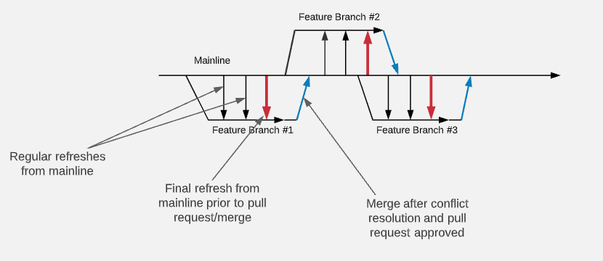
Developing in a Branch
Notes:
AKA trunk-based development

Slide 264
Managing Releases
Optionally, release branches can be used for managing releases of the software
Provides a point-in-time version snapshot
If bugs are found in a release, fixes need to be made in both release branch and mainline
Couple of options: fix in mainline and port to release branch or fix in release branch and backport to mainline

Slide 265
Knowledge Check
Which of the following best describes why we use feature branches?
A. It’s the branch where all major release will be built from
B. It helps developers keep feature updates/bug fixes separate from the main branch
Enter the letter corresponding to your answer in chat

Slide 266
Knowledge Check
Why do we use pull requests?
To ensure code is reviewed before merging to the main release branch
To ensure that unit testing is done before merging to the main
Enter the letter corresponding to your answer in chat

Slide 267
Knowledge Check
How do we mitigate merge conflicts with our long living feature branches?
By running continuous tests on our feature branch code
By regularly merging the main branch into the feature branch during development
Enter the letter corresponding to your answer in chat

Slide 268




Thank you!
If you have additional questions, please reach out to me at:
erik-gross@pluralsight.com

